Slide 1
Chapter 24 Implementing Lists, Stacks, Queues, and Priority Queues

Slide 2
Objectives
To design common features of lists in an interface and provide skeleton implementation in an abstract class (§24.2).
To design and implement a dynamic list using an array (§24.3).
To design and implement a dynamic list using a linked structure (§24.4).
To design and implement a stack class using an array list and a queue class using a linked list (§24.5).
To design and implement a priority queue using a heap (§24.6).

Slide 3
Lists
A list is a popular data structure to store data in sequential order.
For example, a list of students, a list of available rooms, a list of cities, and a list of books, etc. can be stored using lists.
The common operations on a list are usually the following:
· Retrieve an element from this list.
· Insert a new element to this list.
· Delete an element from this list.
· Find how many elements are in this list.
· Find if an element is in this list.
· Find if this list is empty.

Slide 4
Two Ways to Implement Lists
There are two ways to implement a list.
Using arrays. First approach is to use an array to store the elements. The array is dynamically created. If the capacity of the array is exceeded, create a new larger array and copy all the elements from the current array to the new array.
Using linked list. The other approach is to use a linked structure. A linked structure consists of nodes. Each node is dynamically created to hold an element. All the nodes are linked together to form a list.

Slide 5
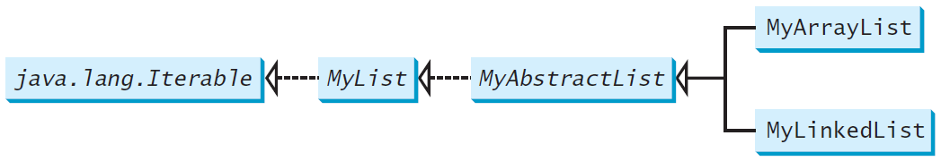
Design of ArrayList and LinkedList
For convenience, let’s name these two classes: MyArrayList and MyLinkedList. These two classes have common operations, but different data fields.
The common operations can be generalized in an interface or an abstract class.
A good strategy is to combine the features of interfaces and abstract classes by providing both interface and abstract class in the design so the user can use either the interface or the abstract class whichever is convenient

Slide 6
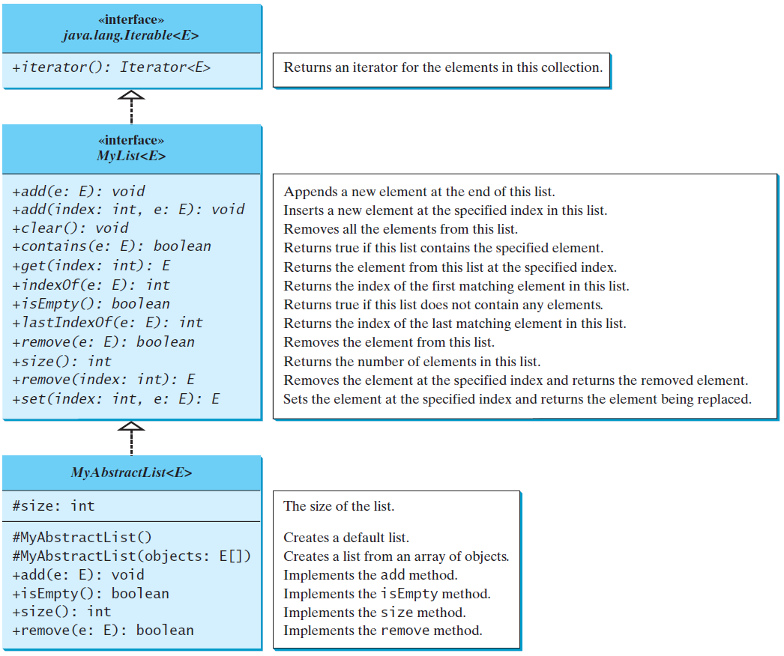
MyList Interface and MyAbstractList Class
MyList
MyAbstractList

Slide 7
Array Lists
Array is a fixed-size data structure. Once an array is created, its size cannot be changed.
However, you can still use array to implement dynamic data structures. The trick is to create a new larger array to replace the current array if the current array cannot hold new elements in the list.
Initially, an array, say data of Object[] type, is created with a default size.
When inserting a new element into the array, first ensure there is enough room in the array. If not, create a new array with the size as twice as the current one. Copy the elements from the current array to the new array. The new array now becomes the current array.

Slide 8
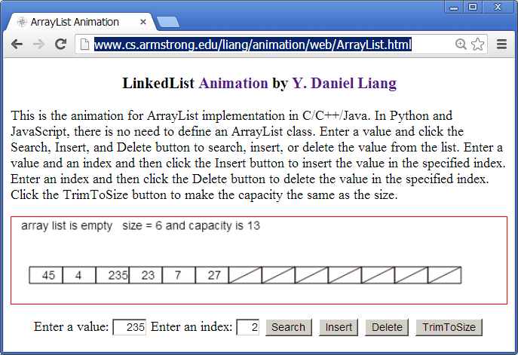
Array List Animation
www.cs.armstrong.edu/liang/animation/web/ArrayList.html

Slide 9
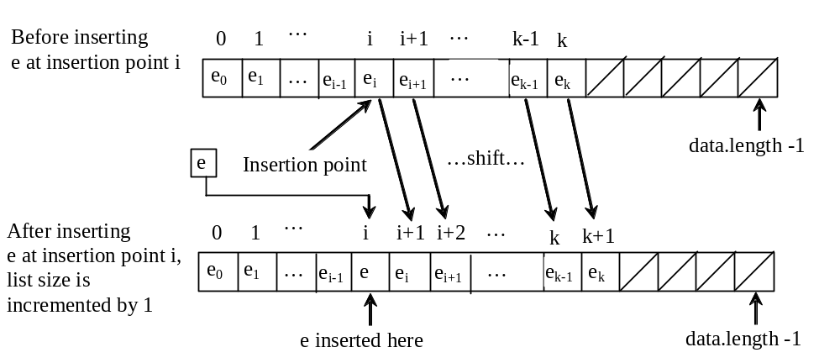
Insertion
Before inserting a new element at a specified index, shift all the elements after the index to the right and increase the list size by 1.

Slide 10
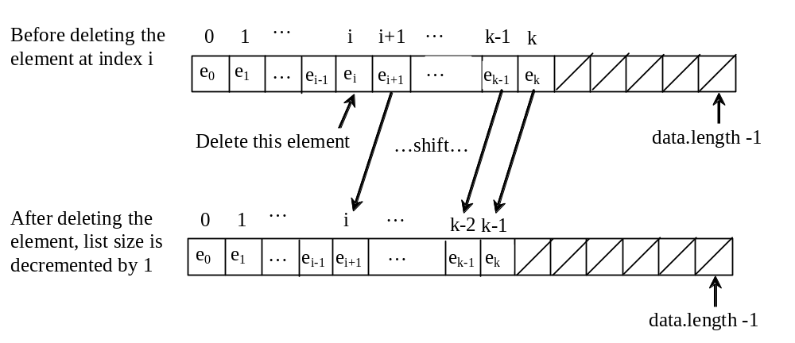
Deletion
To remove an element at a specified index, shift all the elements after the index to the left by one position and decrease the list size by 1.

Slide 11
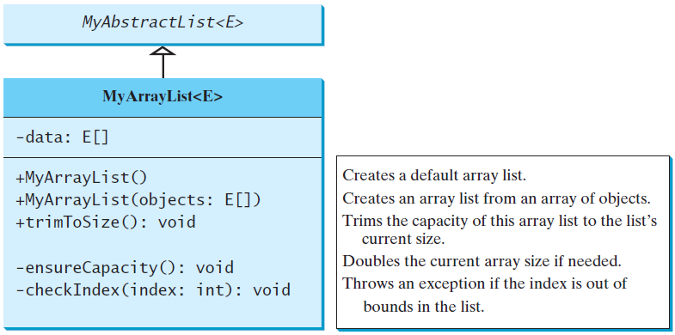
Implementing MyArrayList
MyArrayList
TestMyArrayList
Run

Slide 12
Linked Lists
Since MyArrayList is implemented using an array, the methods get(int index) and set(int index, Object o) for accessing and modifying an element through an index and the add(Object o) for adding an element at the end of the list are efficient.
However, the methods add(int index, Object o) and remove(int index) are inefficient because it requires shifting potentially a large number of elements.
You can use a linked structure to implement a list to improve efficiency for adding and removing an element anywhere in a list.

Slide 13
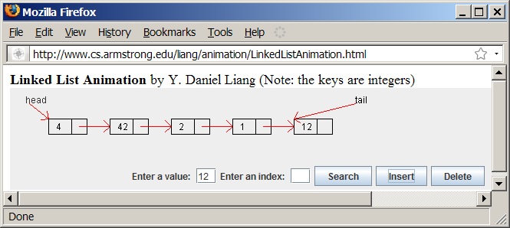
Linked List Animation
www.cs.armstrong.edu/liang/animation/web/LinkedList.html

Slide 14
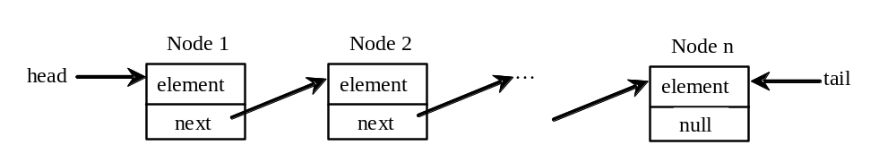
Nodes in Linked Lists
A linked list consists of nodes. Each node contains an element, and each node is linked to its next neighbor. Thus a node can be defined as a class, as follows:
class Node<E> {
E element;
Node<E> next;
public Node(E o) {
element = o;
}
}

Slide 15
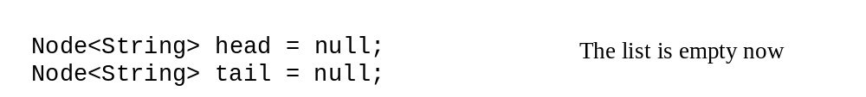
Adding Three Nodes
The variable head refers to the first node in the list, and the variable tail refers to the last node in the list. If the list is empty, both are null.
For example, you can create three nodes to store three strings in a list, as follows:
Step 1: Declare head and tail:

Slide 16
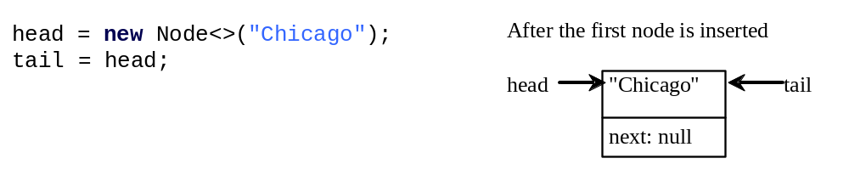
Adding Three Nodes, cont.
Step 2: Create the first node and insert it to the list:

Slide 17
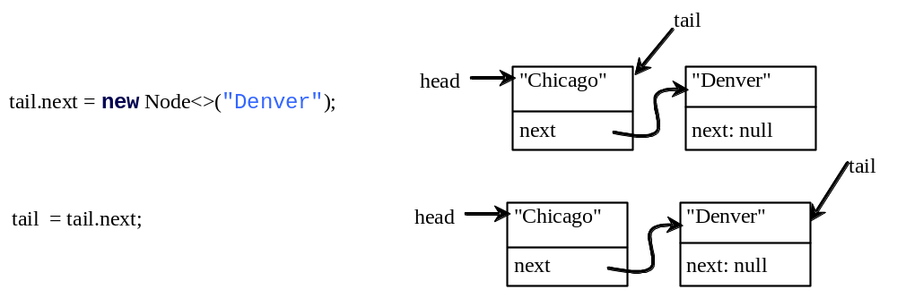
Adding Three Nodes, cont.
Step 3: Create the second node and insert it to the list:

Slide 18
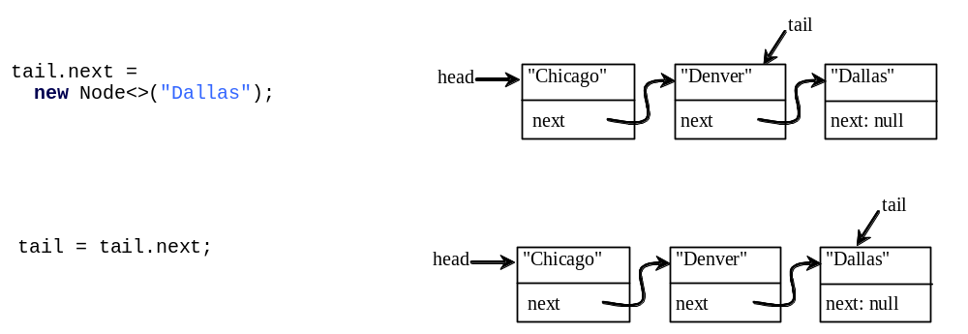
Adding Three Nodes, cont.
Step 4: Create the third node and insert it to the list:

Slide 19
Traversing All Elements in the List
Each node contains the element and a data field named next that points to the next node.
If the node is the last in the list, its pointer data field next contains the value null.
You can use this property to detect the last node. For example, you may write the following loop to traverse all the nodes in the list.
Node<E> current = head;
while (current != null) {
System.out.println(current.element);
current = current.next;
}

Slide 20
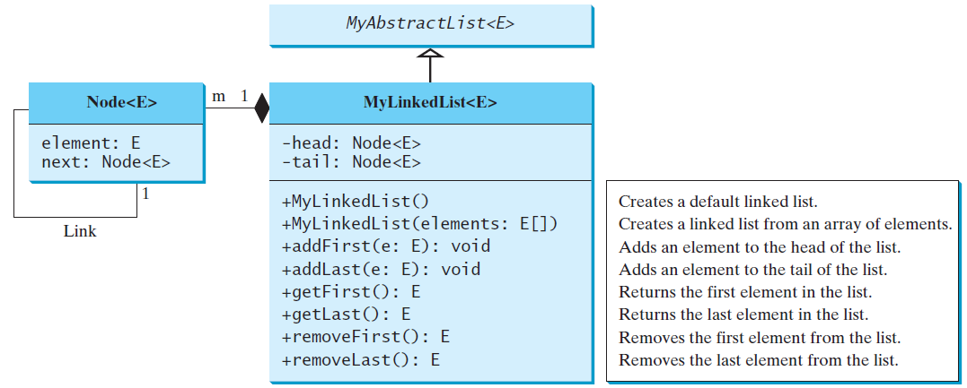
MyLinkedList
MyLinkedList
TestMyLinkedList
Run

Slide 21
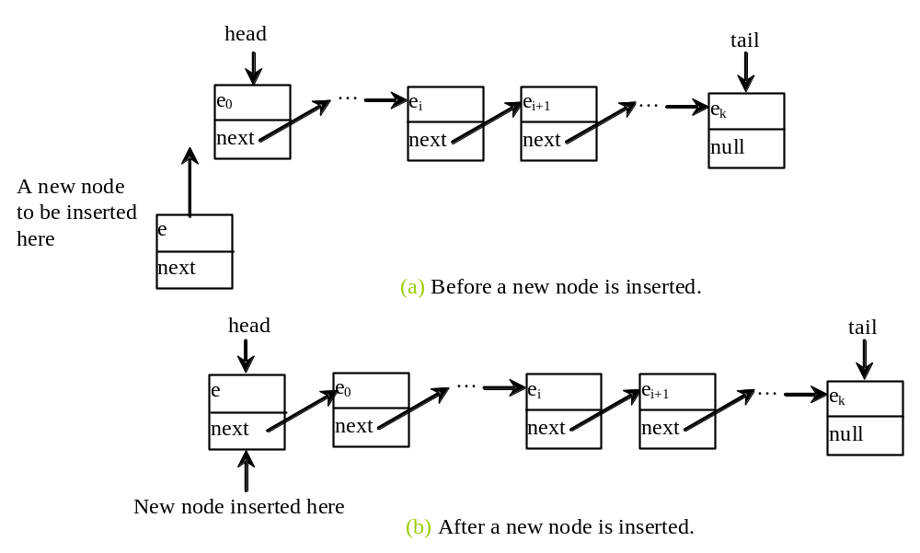
Implementing addFirst(E e)
public void addFirst(E e) {
Node<E> newNode = new Node<>(e);
newNode.next = head;
head = newNode;
size++;
if (tail == null)
tail = head;
}

Slide 22
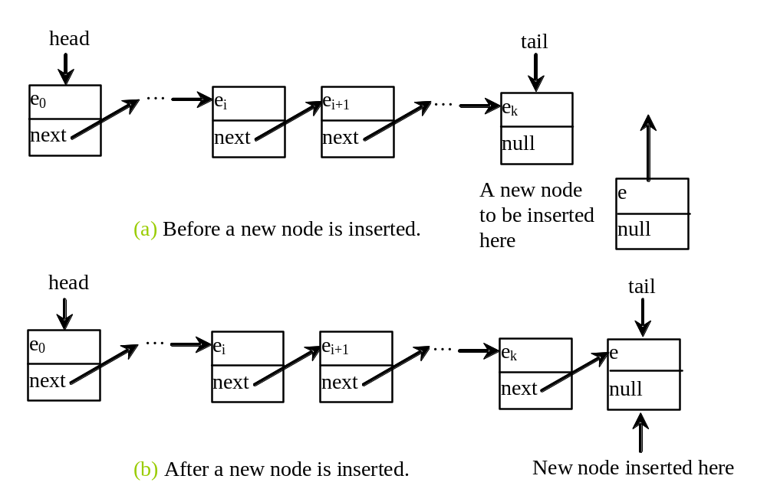
Implementing addLast(E e)
public void addLast(E e) {
if (tail == null) {
head = tail = new Node<>(e);
}
else {
tail.next = new Node<>(e);
tail = tail.next;
}
size++;
}

Slide 23
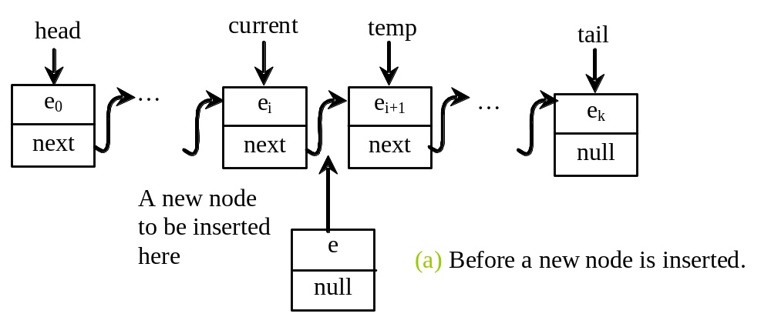
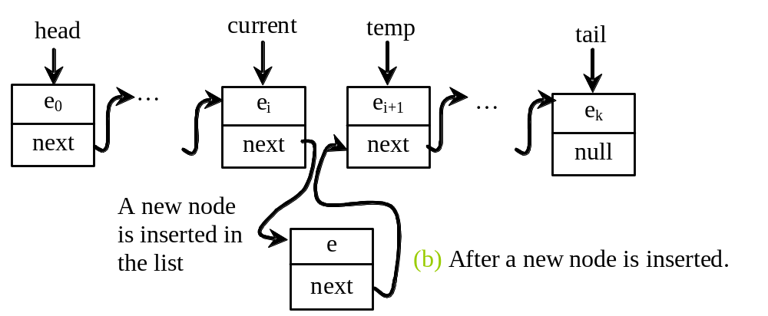
Implementing add(int index, E e)
public void add(int index, E e) {
if (index == 0) addFirst(e);
else if (index >= size) addLast(e);
else {
Node<E> current = head;
for (int i = 1; i < index; i++)
current = current.next;
Node<E> temp = current.next;
current.next = new Node<>(e);
(current.next).next = temp;
size++;
}
}

Slide 24
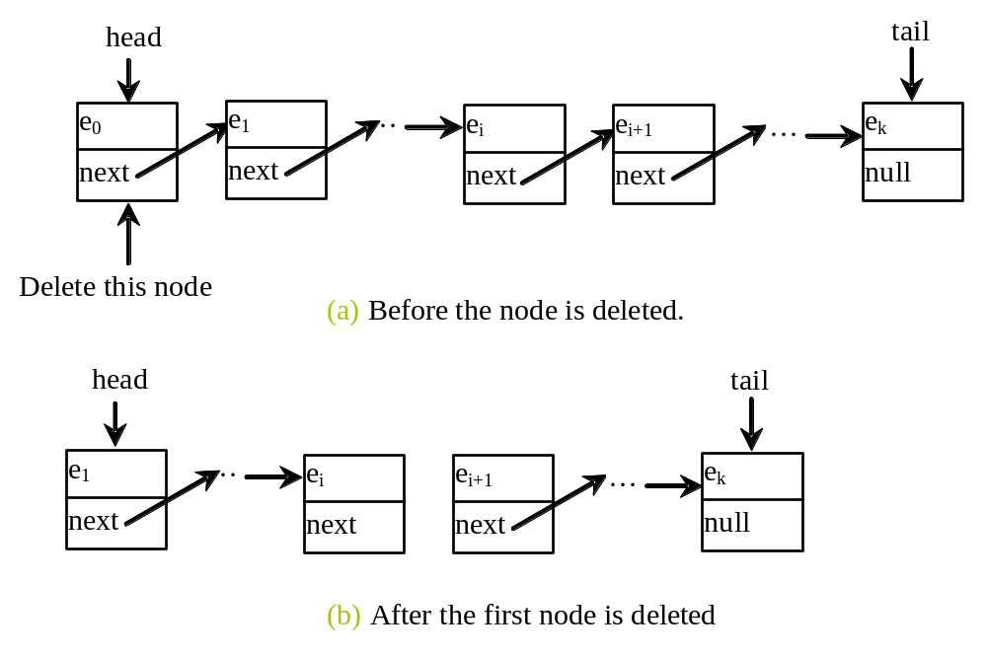
Implementing removeFirst()
public E removeFirst() {
if (size == 0) return null;
else {
Node<E> temp = head;
head = head.next;
size--;
if (head == null) tail = null;
return temp.element;
}
}

Slide 25
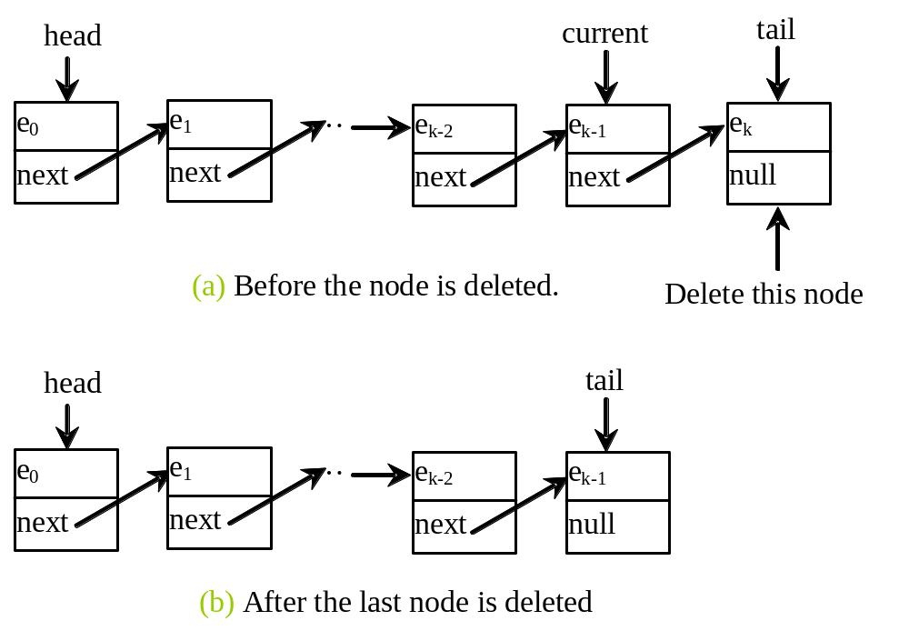
Implementing removeLast()
public E removeLast() {
if (size == 0) return null;
else if (size == 1)
{
Node<E> temp = head;
head = tail = null;
size = 0;
return temp.element;
}
else
{
Node<E> current = head;
for (int i = 0; i < size - 2; i++)
current = current.next;
Node temp = tail;
tail = current;
tail.next = null;
size--;
return temp.element;
}
}

Slide 26
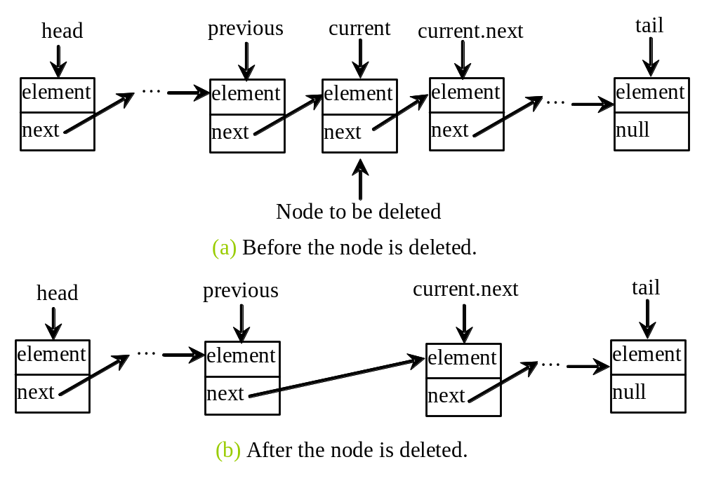
Implementing remove(int index)
public E remove(int index) {
if (index < 0 || index >= size) return null;
else if (index == 0) return removeFirst();
else if (index == size - 1) return removeLast();
else {
Node<E> previous = head;
for (int i = 1; i < index; i++) {
previous = previous.next;
}
Node<E> current = previous.next;
previous.next = current.next;
size--;
return current.element;
}
}

Slide 27
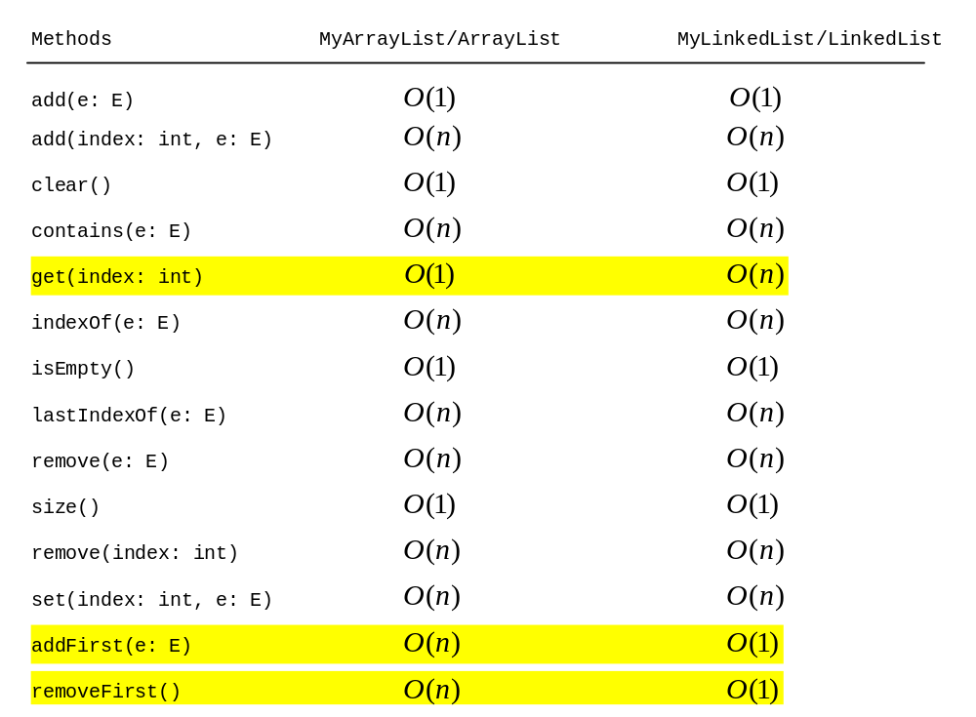
Time Complexity for ArrayList and LinkedList

Slide 28
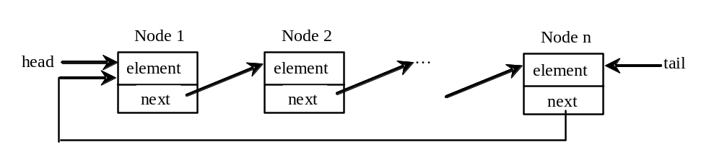
Circular Linked Lists
A circular, singly linked list that the pointer of the last node points back to the first node.

Slide 29
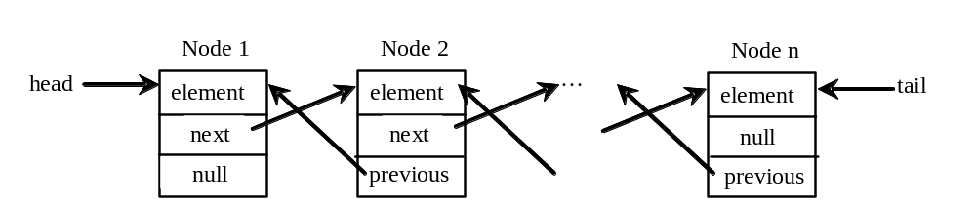
Doubly Linked Lists
A doubly linked list contains the nodes with two pointers. One points to the next node and the other points to the previous node.
These two pointers are conveniently called a forward pointer and a backward pointer. So, a doubly linked list can be traversed forward and backward.

Slide 30
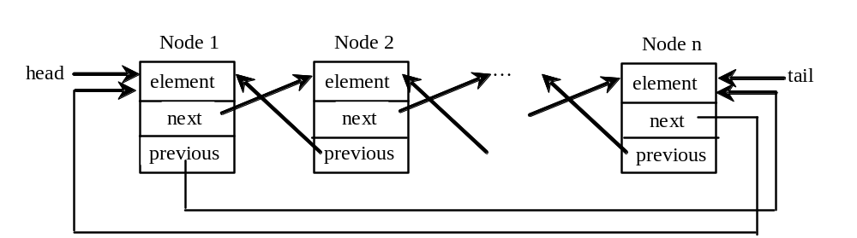
Circular Doubly Linked Lists
A circular, doubly linked list is doubly linked list, except that the forward pointer of the last node points to the first node and the backward pointer of the first pointer points to the last node.

Slide 31
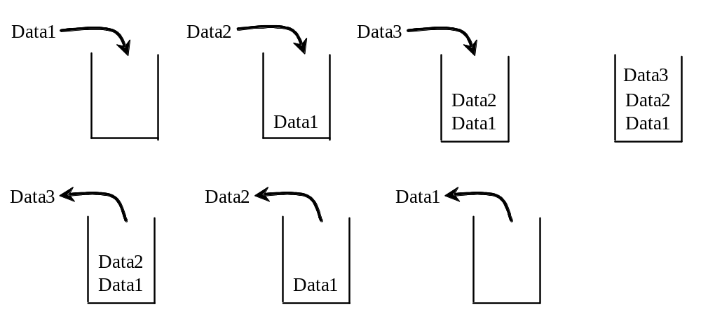
Stacks
A stack can be viewed as a special type of list, where the elements are accessed, inserted, and deleted only from the end, called the top, of the stack. First In Last Out (FILO).

Slide 32
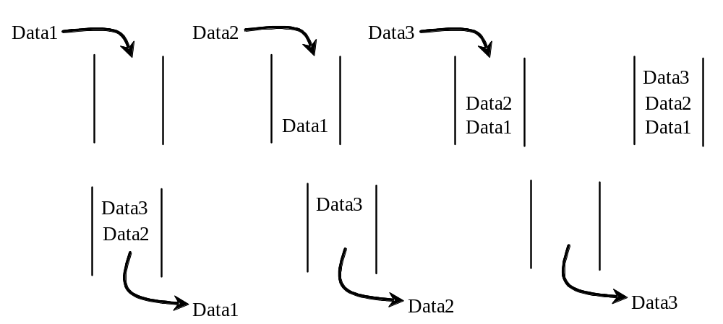
Queues
A queue represents a waiting list. A queue can be viewed as a special type of list, where the elements are inserted into the end (tail) of the queue, and are accessed and deleted from the beginning (head) of the queue. First In First Out (FIFO)

Slide 33
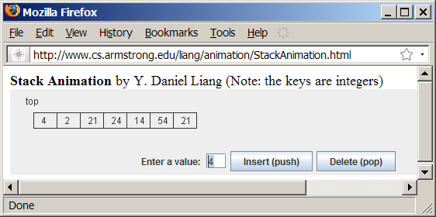
Stack Animation
www.cs.armstrong.edu/liang/animation/web/Stack.html

Slide 34
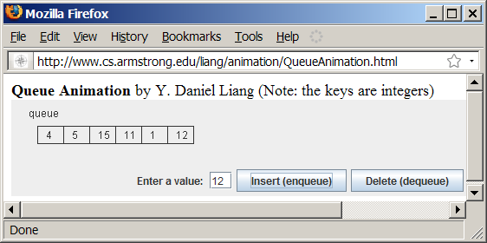
Queue Animation
www.cs.armstrong.edu/liang/animation/web/Queue.html

Slide 35
Implementing Stacks and Queues
Using an array list to implement Stack
Use a linked list to implement Queue
Since the insertion and deletion operations on a stack are made only at the end of the stack, using an array list to implement a stack is more efficient than a linked list.
Since deletions are made at the beginning of the list, it is more efficient to implement a queue using a linked list than an array list.
A stack is implemented by using an array list and a queue is implemented by using a linked list.

Slide 36
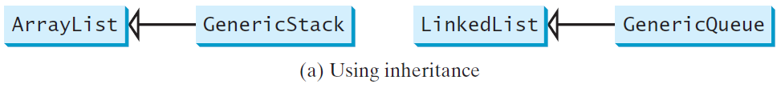
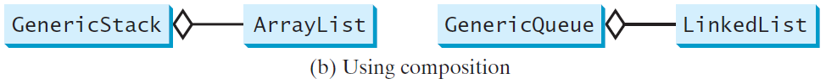
Design of the Stack and Queue Classes
There are two ways to design the stack and queue classes:
  Using inheritance: You can define the stack class by extending the array list class, and the queue class by extending the linked list class.
  Using composition: You can define an array list as a data field in the stack class, and a linked list as a data field in the queue class.

Slide 37
Composition is Better
Both designs are fine, but using composition is better because it enables you to define a complete new stack class and queue class without inheriting the unnecessary and inappropriate methods from the array list and linked list.

Slide 38
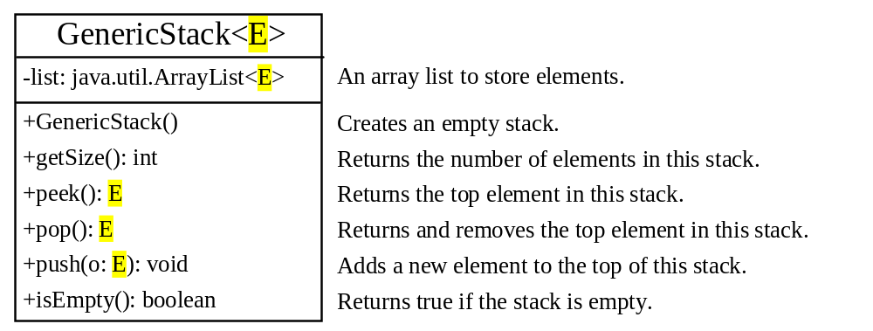
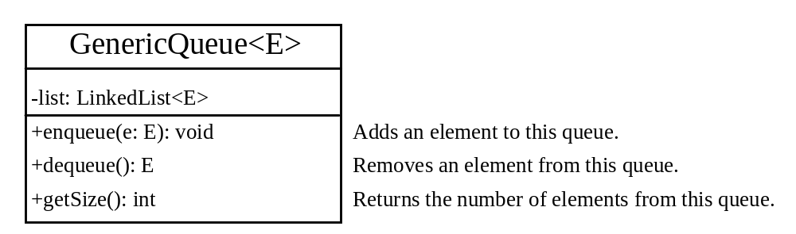
MyStack and MyQueue
GenericStack
GenericQueue

Slide 39
Example: Using Stacks and Queues
Write a program that creates a stack using MyStack and a queue using MyQueue. It then uses the push (enqueu) method to add strings to the stack (queue) and the pop (dequeue) method to remove strings from the stack (queue).
TestStackQueue
Run

Slide 40
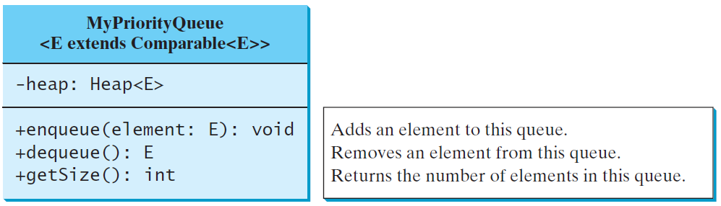
Priority Queue
A regular queue is a first-in and first-out data structure. Elements are appended to the end of the queue and are removed from the beginning of the queue.
In a priority queue, elements are assigned with priorities. When accessing elements, the element with the highest priority is removed first. A priority queue has a largest-in, first-out behavior. For example, the emergency room in a hospital assigns patients with priority numbers; the patient with the highest priority is treated first.
MyPriorityQueue
TestPriorityQueue
Run

